Slide 1
NewRocket - Boeing POC Demo #2
Friday, 2 January 2026

Slide 2
Today’s Agenda
Skill: Interaction Sentiment
Agent: Phoebe Resolution analysis
Agent: Elara, side-by-side comparison
Skill: Description Summary

Slide 3

Skill: Interaction Sentiment Analysis
Sentiment Analysis can help you gauge customer emotions, enabling you to provide more empathetic and compassionate customer experiences
Skill = NR Interaction Sentiment Analysis
Key Capabilities enabled for Boeing POC
Use case
When an agent or requester completes a chat, the overall sentiment is evaluated, and the value Positive/Neutral/Negative is filled in the IMS Sentiment field of the interaction.
The skill looks at the overall tone of the chat and does not necessarily look at the resolution of the interaction.

Slide 4
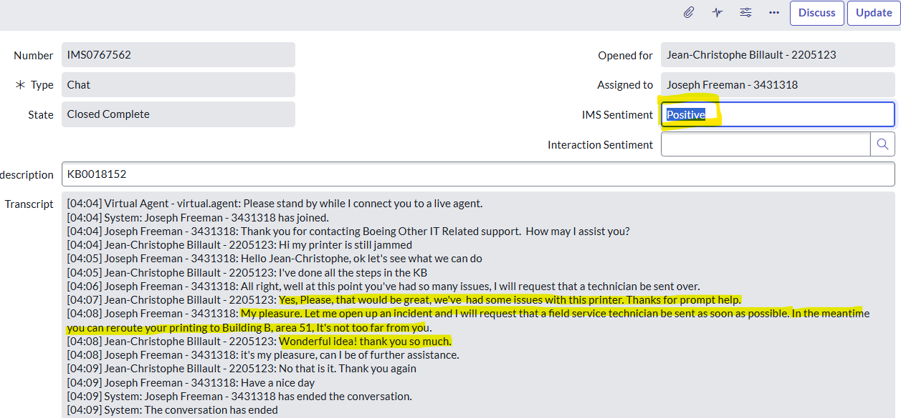
Skill: Sentiment Analysis - Positive

Slide 5
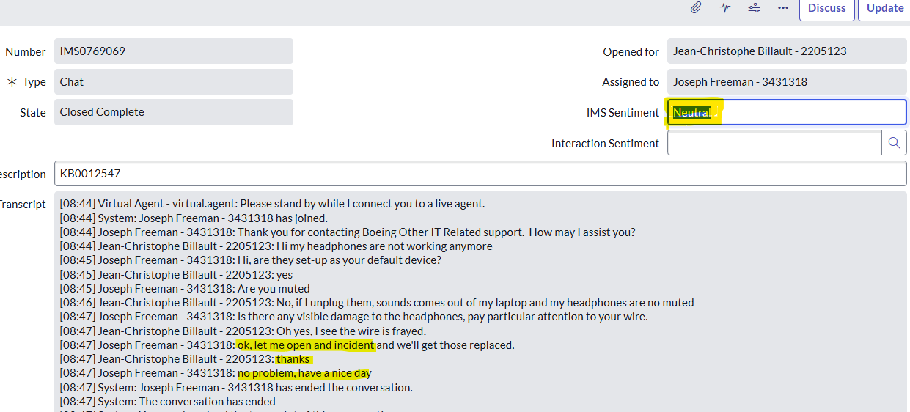
Skill: Sentiment Analysis - Neutral

Slide 6
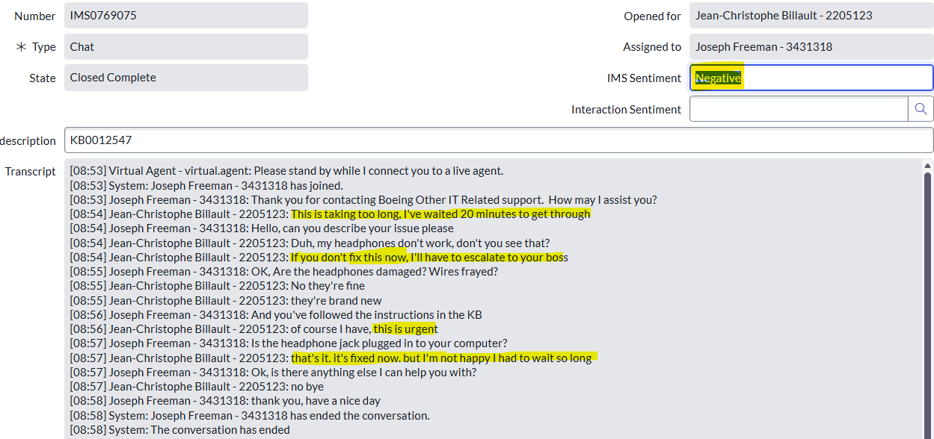
Skill: Sentiment Analysis - Negative

Slide 7
DEMO Interaction Sentiment Analysis (negative with no resolution)
Notes:
[10:52] Virtual Agent - virtual.agent: Please stand by while I connect you to a live agent.
[10:52] System: Joseph Freeman - 3431318 has joined.
[10:52] Joseph Freeman - 3431318: Thank you for contacting Boeing Other IT Related support. How may I assist you?
[10:52] Jean-Christophe Billault - 2205123: This is ridiculous, my camera is still not working after I did all this work. you have been ignoring me for the past 3 hours. I'm very upset.
[10:53] Joseph Freeman - 3431318: I can help you. Is the camera privacy cover on
[10:53] Jean-Christophe Billault - 2205123: no
[10:53] Joseph Freeman - 3431318: Just so I understand, did you try everything in the KB?
[10:54] Jean-Christophe Billault - 2205123: Yes, I followed this and it's all ok: The camera is muted.
Camera lens is closed or lens cap is on.
The camera is blocked.
Video source is not set to main cam or 2nd cam in a multi-camera setup.
[10:55] Jean-Christophe Billault - 2205123: None of it applies. You need to hurry because I have an important call today and the camera must work
[10:56] Joseph Freeman - 3431318: Ok, I see that your camera firmware version is older, I think we'll need to make sure it's at the latest version. I'll open a ticket and get it resolved as soon as possible
[10:56] Jean-Christophe Billault - 2205123: You better hurry, this is not ok.
[10:57] Joseph Freeman - 3431318: No problem, I'll get that going as soon as possible
[10:57] Joseph Freeman - 3431318: Is there anything else you need
[10:57] Jean-Christophe Billault - 2205123: no it's enough for today, you guys are not the greatest
[10:57] Joseph Freeman - 3431318: Have a nice day

Slide 8

Skill: Incident Description Summary
The skill Incident Description Summary is augmented from the OOTB Incident summary.
It is designed to trigger on incident creation, when an incident is created through a record producer and summarizes the Description only.
Key Capabilities enabled for Boeing POC
Use case
When a requester opens an incident through a record producer, currently all the answers get written with no formatting to the output, making it difficult for the agent to read through the actual issue.
The new incident description summarization skill takes the content of this "jumbled" data and summarizes while keeping the original answers in the description.

Slide 9
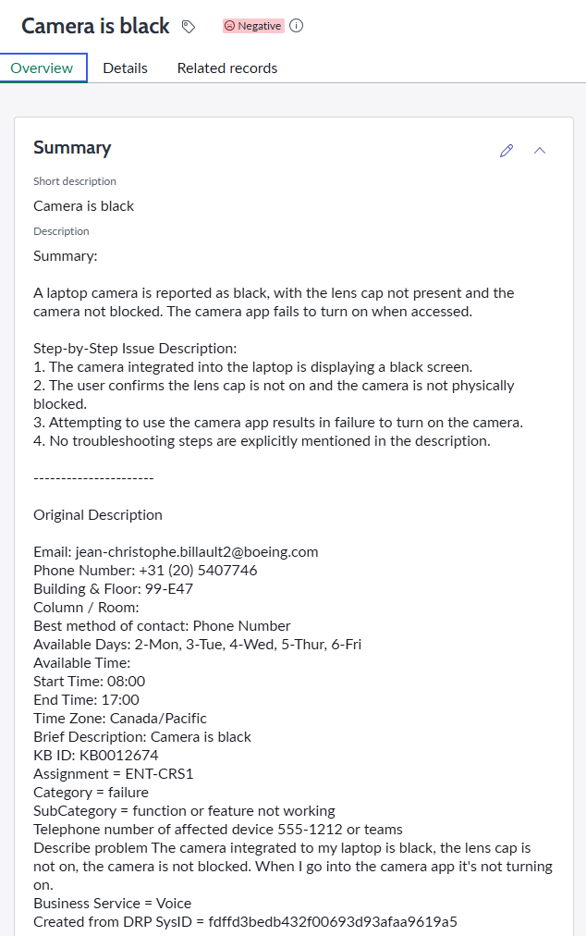
Skill: Incident Description Summary
The new skill summarizes the content of the data obtained through the record producer form
The original data are still accessible to the agent

Slide 10
DEMO Incident Description Summarization

Slide 11

Phoebe – Additional features
In this iteration of Phoebe, we have added made it more interactive, adding additional comments for the requester. We have also stopped it from interacting with Event Management incidents
Additional Key Capabilities enabled for Boeing POC
Use case #1 – Self-resolution for In-progress/on-hold Incidents
When a requester enters any of the following statements:
I fixed the issue myself/It's fixed
No longer required/Cancel the incident
Then Phoebe puts a follow-up in additional comments for the requester and resolves the incident
Use case #2 – Incident was resolved but re-opened by requester
On incident state change from Resolved to In progress, Phoebe will:
Analyze resolution notes, any additional comments added
Engage with the requester, providing further help
If the result of the conversation is deemed to be a new incident, Phoebe leaves the current incident resolved and puts a follow up indicating how to open a new incident
If the result of the conversation is deemed to be the same issue as the current incident, Phoebe re-opens the incident in progress and assigned to its original assignee

Slide 12
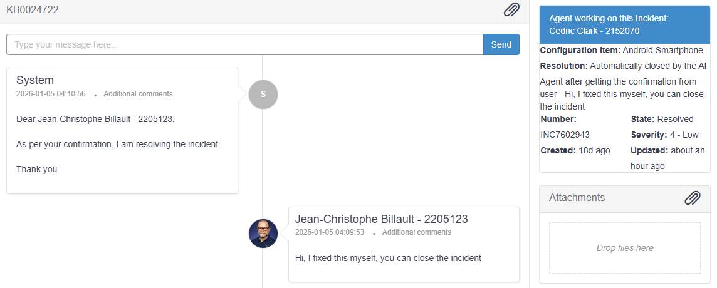
Phoebe: Self-resolution (State = In progress or On Hold)

Slide 13
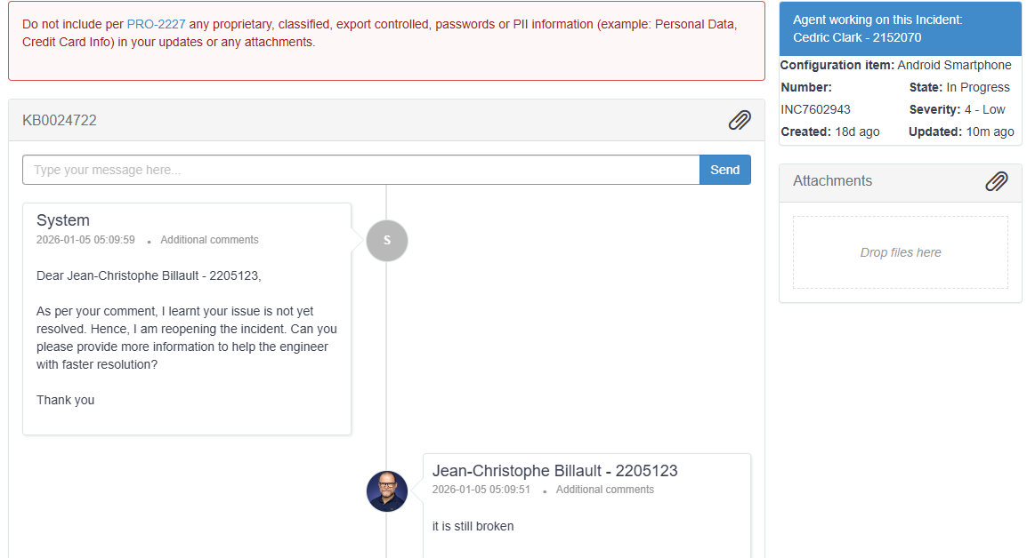
Phoebe: Re-opening - same issue

Slide 14
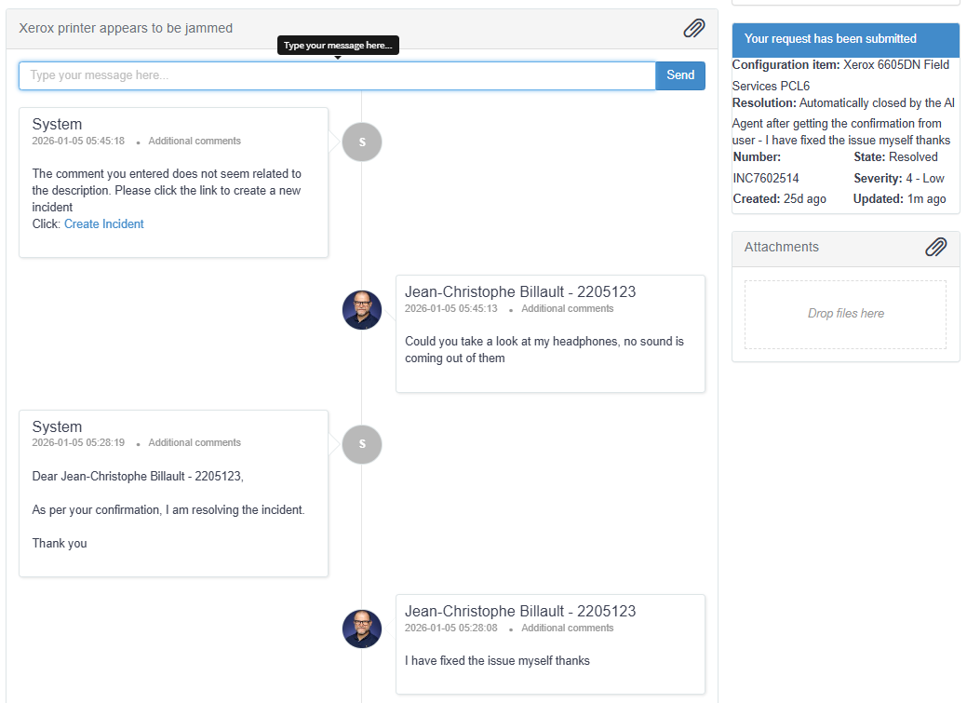
Phoebe: Re-opening Different issue

Slide 15
DEMO: Phoebe – Incident Management

Slide 16

Wrap Up
This Photo by Unknown Author is licensed under CC BY-SA-NC

Slide 17


Thank You
The AI-first ServiceNow® Elite Partner
October 22, 2025

